Slide 2
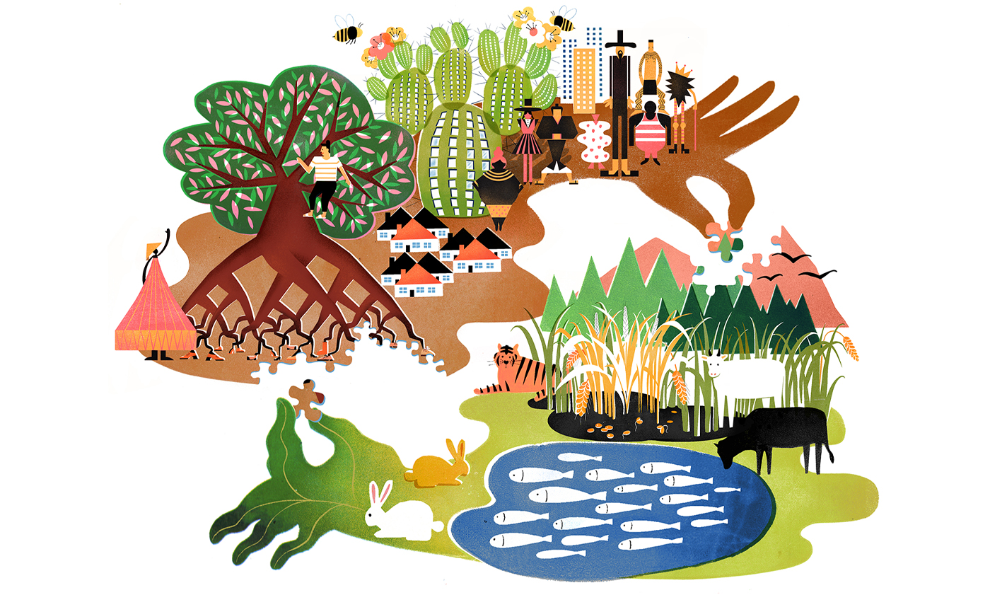

Slide 3
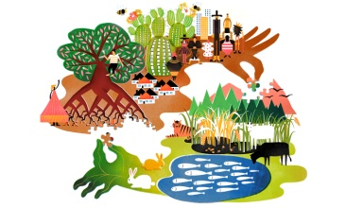
Ecosystems: Concept, Structure and Functions of Ecosystems

Slide 4
Concept of an Ecosystem
Living organisms cannot live isolated from their non-living environment be­cause the latter provides materials and energy for the survival of the former i.e. there is interaction between a biotic community and its environment to produce a stable system; a natural self-sufficient unit which is known as an ecosystem.
An ecosystem is, therefore, defined as a natural functional ecological unit com­prising of living organisms (biotic community) and their non-living (abiotic or physio chemical) environment that interact to form a stable self-supporting sys­tem. A pond, lake, desert, grassland, meadow, forest etc. are common examples of ecosystems.

Slide 5
Structure and Function of an Ecosystem

Slide 7
Each Ecosystem Has Two Main Components:
ABIOTIC
BIOTIC

Slide 8
1. Abiotic Components:
The non living factors or the physical environment prevailing in an ecosystem form the abiotic components. They have a strong influence on the structure, distribution, behavior and inter-relationship of organisms.
Abiotic components are mainly of two types:
(a) Climatic Factors:
Which include rain, temperature, light, wind, humidity etc.
(b) Edaphic Factors
Which include soil, pH, topography minerals etc.

Slide 9
The Functions Of Important Factors In Abiotic Components
Soils - Solis are much more complex than simple sediments. They contain a mixture of weathered rock fragments, highly altered soil mineral particles, organic mat­ter, and living organisms. Soils provide nutrients, water, a home, and a struc­tural growing medium for organisms. The vegetation found growing on top of a soil is closely linked to this component of an ecosystem through nutrient cycling.
Solar radiation is used in ecosystems to heat the atmosphere and to evapo­rate and transpire water into the atmosphere. Sunlight is also necessary for photosynthesis. Photosynthesis provides the energy for plant growth and me­tabolism, and the organic food for other forms of life.
Water is the medium by which mineral nutrients enter and are trans-located in plants. It is also necessary for the maintenance of leaf turgidity and is required for photosynthetic chemical reactions. Plants and animals receive their water from the Earth’s surface and soil. The original source of
this water is precipita­tion from the atmosphere.

Slide 10
(2) Biotic Components:
On the basis of their role in the ecosystem the biotic components can be classi­fied into three main groups:
PRODUCERS
CONSUMERS
DECOMPOSERS

Slide 11
1. PRODUCERS
Also Known as Autotrophs
The green plants have chlorophyll with the help of which they trap solar energy and change it into chemical energy of carbohydrates using simple inorganic compounds namely water and carbon dioxide.
This process is known as photo­synthesis. As the green plants manufacture their own food they are known as Autotrophs (i.e. auto = self, trophos = feeder)
The chemical energy stored by the producers is utilised partly by the producers for their own growth and survival and the remaining is stored in the plant parts for their future use.

Slide 12
2. CONSUMERS
The animals lack chlorophyll and are unable to synthesise their own food. Therefore, they depend on the producers for their food. They are known as heterotrophs (i.e. heteros = other, trophos = feeder)
The consumers are of four types, namely:
(a) Primary Consumers or First Order Consumers or Herbivores:
These are the animals which feed on plants or the producers. They are called her­bivores. Examples are rabbit, deer, goat, cattle etc.
(b) Secondary Consumers or Second Order Consumers or Primary Carnivores:
The animals which feed on the herbivores are called the pri­mary carnivores. Examples are cats, foxes, snakes etc.
(c) Tertiary Consumers or Third Order Consumers:
These are the large carnivores which feed on the secondary consumers. Example are Wolves.
(d) Quaternary Consumers or Fourth Order Consumers or Omnivores:
These are the largest carnivores which feed on the tertiary consumers and are not eaten up by any other animal. Examples are lions and tigers.

Slide 13
3. DECOMPOSERS OR REDUCERS
Also Called Saptotrophs
Bacteria and fungi belong to this category. They breakdown the dead organic materials of producers (plants) and consumers (animals) for their food and re­lease to the environment the simple inorganic and organic substances produced as by-products of their metabolisms.
These simple substances are reused by the producers resulting in a cyclic ex­change of materials between the biotic community and the abiotic environment of the ecosystem. The decomposers are known as Saprotrophs (i.e., sapros = rotten, trophos = feeder)

Slide 14
Edaphic - of, produced by, or influenced by the soil.
Topography refers to the form of the landscape—its steepness, shape, and slope aspect (the direction a slope faces). Even within a relatively small area, variations in topography can create variations in temperature, moisture, and exposure to sun and wind.
AUTOTROPHS - an organism that is able to form nutritional organic substances from simple inorganic substances such as carbon dioxide.
Saprotrophs - an organism that feeds on or derives nourishment from decaying organic matter.

Slide 15
TROPHIC LEVEL

Slide 18
TROPHIC LEVEL
Trophic level - step in a nutritive series, or food chain, of an ecosystem.
The organisms of a chain are classified into these levels on the basis of their feeding behaviour.
The first and lowest level contains the producers, green plants.
The plants or their products are consumed by the second-level organisms—the herbivores, or plant eaters.
At the third level, primary carnivores, or meat eaters, eat the herbivores.
At the fourth level, secondary carnivores eat the primary carnivores.
These categories are not strictly defined, as many organisms feed on several trophic levels; for example, some carnivores also consume plant materials and are called omnivores, and some herbivores occasionally consume animal matter.
5. Separate trophic level, the decomposers or transformers, consists of organisms such as bacteria and fungi that break down dead organisms and waste materials into nutrients usable by the producers.

Slide 19
Food Chain
A food chain refers to the order of events in an ecosystem, where one living organism eats another organism, and later that organism is consumed by another larger organism. The flow of nutrients and energy from one organism to another at different trophic levels forms a food chain.
The food chain also explains the feeding pattern or relationship between living organisms. Trophic level refers to the sequential stages in a food chain, starting with producers at the bottom, followed by primary, secondary and tertiary consumers. Every level in a food chain is known as a trophic level.

Slide 22
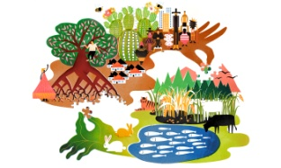
The food chain consists of four major parts, namely:
The Sun: The sun is the initial source of energy, which provides energy for everything on the planet.
Producers: The producers in a food chain include all autotrophs such as phytoplankton, cyanobacteria, algae, and green plants. This is the first stage in a food chain. The producers make up the first level of a food chain. The producers utilise the energy from the sun to make food. Producers are also known as autotrophs as they make their own food. Producers are any plant or other organisms that produce their own nutrients through photosynthesis.
Consumers: Consumers are all organisms that are dependent on plants or other organisms for food. This is the largest part of a food web, as it contains almost all living organisms. It includes herbivores which are animals that eat plants, carnivores which are animals that eat other animals, parasites that live on other organisms by harming them and lastly the scavengers, which are animals that eat dead animals’ carcasses.
Here, herbivores are known as primary consumers and carnivores are secondary consumers. The second trophic level includes organisms that eat producers. Therefore, primary consumers or herbivores are organisms in the second trophic level.
Decomposers: Decomposers are organisms that get energy from dead or waste organic material. This is the last stage in a food chain. Decomposers are an integral part of a food chain, as they convert organic waste materials into inorganic materials, which enriches the soil or land with nutrients.
Decomposers complete a life cycle. They help in recycling the nutrients as they provide nutrients to soil or oceans, that can be utilised by autotrophs or producers. Thus, starting a whole new food chain.

